Slide 1

Privacy Preserving Machine Learning Training
Gauri Gupta - 2017MT60207
Under the supervision of Prof. Rijurekha Sen
Co-supervisor: Prof. RK Sharma
Notes:
Good morning, everyone. I am Gauri Gupta and I am persuing my M.tech thesis under the supervision of Prof. Rijurekha Sen and my co-supervisor from the department is Prof. RK Sharma.
I am working on Privacy preserving ML which is an important research topic these days. There are a lot of recent research papers that are coming in this domain however, there is very limited support in terms of softwares and training tools that support secure computations. In our project we are exploring the most recent and mature tool for privacy training i.e. Crypten (from facebook).
Despite the support from Crypten, it is still under development, and we will discover the various challenges we have faced while deploying our models in crypten.

Slide 2
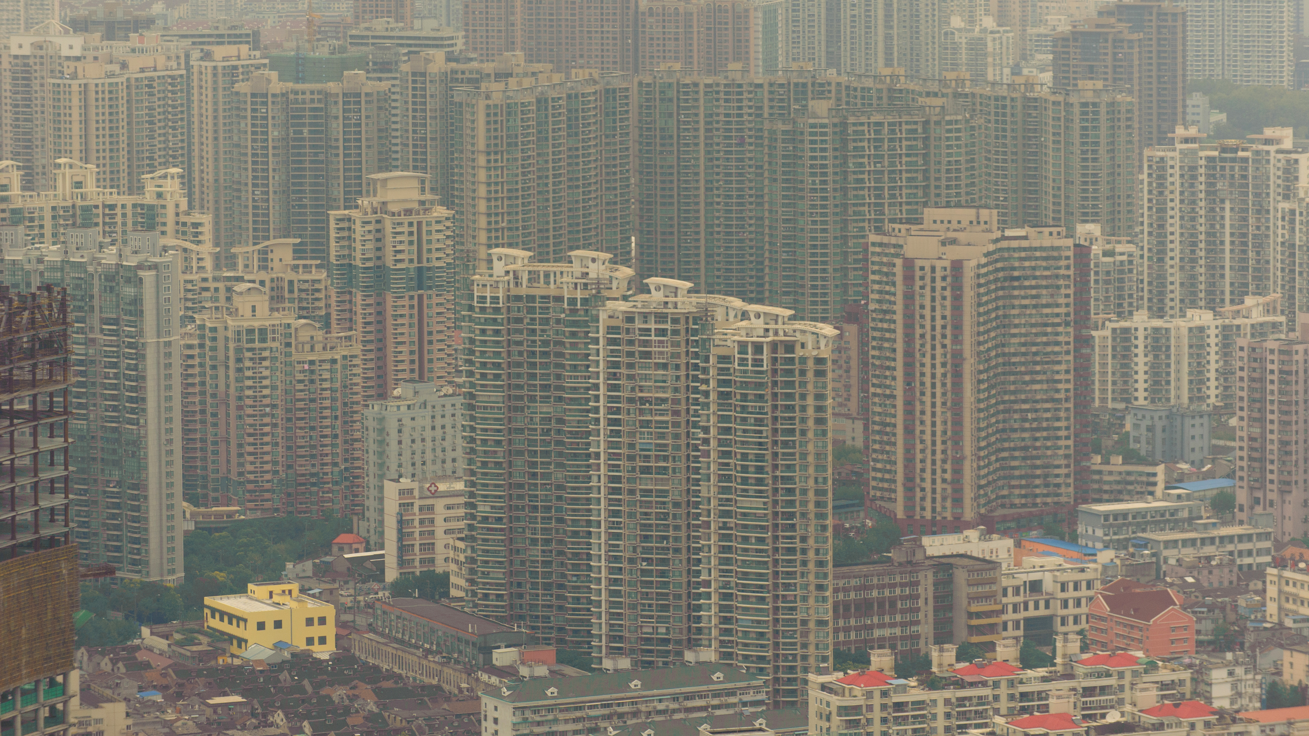

Frist Usecase - Secure Pollution Prediction using GCN’s and GP in Delhi-NCR
This Photo by Unknown author is licensed under CC BY-NC-ND.
Notes:
Good afternoon, everyone. I am Gauri Gupta and I am persuing my M.tech thesis under the supervision of Prof. Rijurekha Sen and my co-supervisor from the department is Prof. RK Sharma. We are working on the project of Privacy preserving Machine Learning where our aim is to do Secure Pollution prediction using GCN and GP.
Air pollution is one of the main problems faced by Delhi today. Cab companies have a growing vehicle feet which they are willing to instrument for measurements of traffic and air pollution. While the data from these companies can be very benecial to analyse, this data can also give
away the vehicle location and the number of vehicles in their fleet. This sensitive data is of high business value to these fleet companies and hence they donot want to compromise their privacy by sharing them.

Slide 3
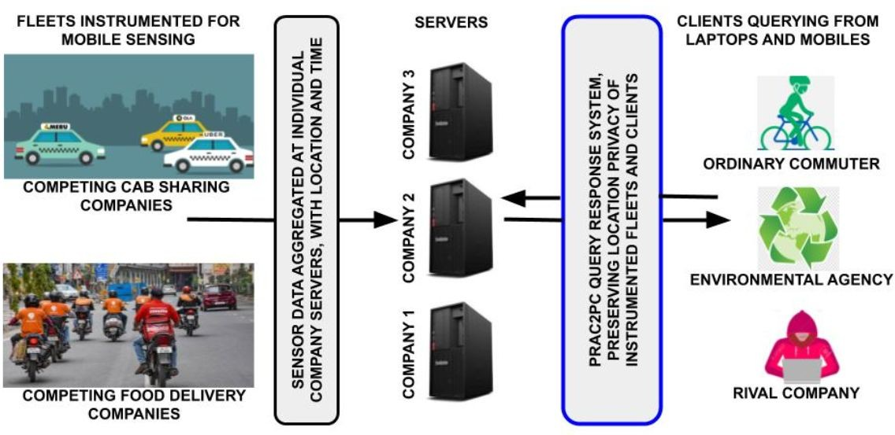
Problem Description
Notes:
The problem involves responding to client queries based on pollution data collected by various cab and delivery companies for a particular city. The client is interested in knowing the level of pollution on their route along with how reliable the information is. At the same time, the client doesn't want to share their exact location. Similarly, the rival companies e.g. Uber, Ola, want their sensitive data to be secure as it is possible to estimate their fleet location using confidence scores. In this project we aim to provide privacy guarantees in the above discussed scenario using secure multiparty computations on ML models like GCN and Gaussian Process Regression (GPR)

Slide 4
Prac2PC
Key points:
based on Yao’s garbled circuit and oblivious transfer (2PC)
a client could ask queries from only a single server
server only performed interpolation on its own data
queries accurate only in areas where one cab company's fleet is located
known
needs interpolation unknown
query path
Notes:
In Prac2PC, a client could ask queries from only a single server. The client does so by engaging a 2 party computation with the server by using Yao's garbled circuits. The server only performs interpolation on its own data which meant that these 2-party queries tend to be accurate only in areas where that particular cab company’s fleet is located.

Slide 5
Extending Prac2PC to PracMPC
Key points:
2PC protocols don’t work in MPC setting
a client asks queries from multiple servers
servers may perform joint interpolation
queries answered using more data — more reliable predictions
known
needs interpolation unknown
query path
Notes:
In this project, we aim to extend 2party computation to Prac MPC. 2-party secure communication protocols used in Prac2PC do not work for the multi-party setting and we needed to explore and use MPC protocols here. Then we extend this to secure interpolation across servers, where servers collectively interpolate their data and then securely answer queries. Also, joint interpolation across various servers leads to better predictions for unknown locations

Slide 6
Phases of the Project
Understanding and exploring secure MPC protocols and libraries
Exploring and studying Crypten library for secure computations
Extend 2PC to multi party computation
Study various ML models like GNNs and GP
Deploy Crypten in GP
Notes:
So, the phases in which our project progressed is,
First we explored and understood various MPC protocols and available libraries. Next, we studied a particular Crypten library developed for secure Multiparty computations in detail. Then we aimed to extend the 2PC to secure MPC. The next task was to study various ML models for the task o interpolation of the pollution values at the unknown grid points. For this, we studied, GCN and GP. Next, we aim to port Crypten in deployment of GP

Slide 7
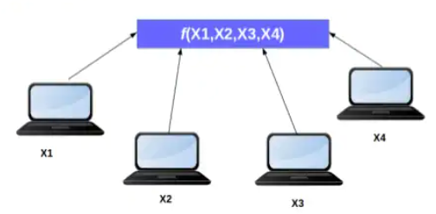
Background - Secure Multi Party Computation (MPC)
Goal: To compute a function of private inputs without revealing information
about the inputs
Motivation: Parties wish to inhibit data sharing due to security concerns.
Secret sharing based protocols are popular techniques to achieve secure multi-party computations.
Notes:
Let us look at the background for secure MPC. Secure multi-party computation is an abstraction that allows multiple parties to compute a function on encrypted data. The protocols are designed such that every party is able to access only their own data and data that all parties agree to reveal. A secure MPC, performs the trusted computation without leaking a party’s information to others. Secret sharing based protocols are popular techniques to achieve secure multi-party computation. In our project we explore the library Crypten which is based on secretsharing protocols.
A set of parties with private inputs wish to compute some joint function of their inputs. Parties wish to preserve some security properties. E.g., privacy and correctness.That is, the process of protocol computation reveals nothing.
Let's look at a concrete example to better understand this abstraction. Suppose we have three parties, A, B and C that each have a private number, and together want to compute the sum of all their private numbers. A secure MPC protocol for this computation will allow each party to learn the final sum; however, they will not learn any information about the other 2 parties' individual private numbers other than the aggregate sum.
In secure MPC, the data owner encrypts its data by splitting it using random masks into n random shares that can be combined to reconstruct the original data. These n shares are then distributed between n parties. This process is called secret sharing. The parties can compute functions on the data by operating on the secret shares and can decrypt the final result by communicating the resulting shares amongst each other.

Slide 8

CrypTen
Uses secret sharing protocols
Private Addition: Parties sum their shares independently
Private Multiplication: Using Beaver triples, requires trusted third party
Linear Functions: Implemented using private additions and multiplications
Non-Linear Functions: Implemented using standard approximations
C++ implementation under the hood
Cryten performance w.r.t other implementations is promising
Notes:
CrypTen is a Privacy Preserving Machine Learning framework written using PyTorch that allows researchers and developers to train models using encrypted data. It currently implements Secure Multiparty Computation as its computing backend. Addition is carried out by simply asking the parties to sum their secret shares and multiplication using Beaver Triples. All linear functions are represented as a combination of addition and multiplication and all non-linear functions are implemented using standard approximations which use addition and multiplication. Crypten is built on Pytorch, has a C++ implementation under the hood and is promising for achieving secure MPC in ML tasks.
CrypTen allows you to develop models with the PyTorch API while performing computations on encrypted data -- without revealing the protected information. CrypTen ensures that sensitive or otherwise private data remains private, while still allowing model inference and training on encrypted data that may be aggregated across various organizations or users. CrypTen currently uses secure multiparty computation (MPC) (see (1)) as its cryptographic paradigm. To use CrypTen effectively, it is helpful to understand the secure MPC abstraction as well as the semi-honest adversarial model in which CrypTen operates. This introduction explains the basic concepts of secure MPC and the threat model. It then explores a few different use cases in which CrypTen may be applied.

Slide 9




Experiments setting and Preprocessing for Interpolation
known
needs interpolation unknown
Private pollution values of party Blue
Shares from all the servers
Blue’s share of merged grid
Notes:
Let us now look at the experiment setting and pre-processing for interpolation. So, the city is divided into grids. The servers have their respective pollution values at different grid points. They secretly share these values and averaging is done on all known points. These steps may be referred to as pre-processing. For the unknown points, we perform interpolation. The interpolation needs to be done securely and the interpolated values are all secure and shared. However, the data is relatively sparse with only values for 2% grid points known in an hour. We explore two machine learning models to achieve this, i.e. using Graph Convolution Networks and using Gaussian Process Interpolation. We discuss the results and issues with these in the remaining presentation. Also note that here the objective here isn't to get the best model to solve the problem but rather to understand how interpolation and learning can happen jointly across parties using available secure protocols and libraries.

Slide 10
GCN for Interpolation
Notes:
Let us see how we used Graph Convolutional Network for interpolation on pollution values.

Slide 11


GCN
Convolutional Layer 2 x 8
Convolutional Layer 8 x 4
Fully Connected Layer 4 x 1
known predictions unknown
Blue’s share of merged grid
Blue’s share of interpolated grid
GCN Architecture
Notes:
The GCN architecture involves two graph convolution layers followed by a fully connected layer. The input to a GCN is a graph and features of nodes of the graph. The input graph has edges between adjacent grid points. The Adjacency matrix is such that there are outgoing edges only from nodes whose values are known. The output is the values of nodes which have to be predicted. This prediction is based on features of nodes and that of their neighbourhood. This way, the unknown points can be predicted by using values of their neighbours.

Slide 12
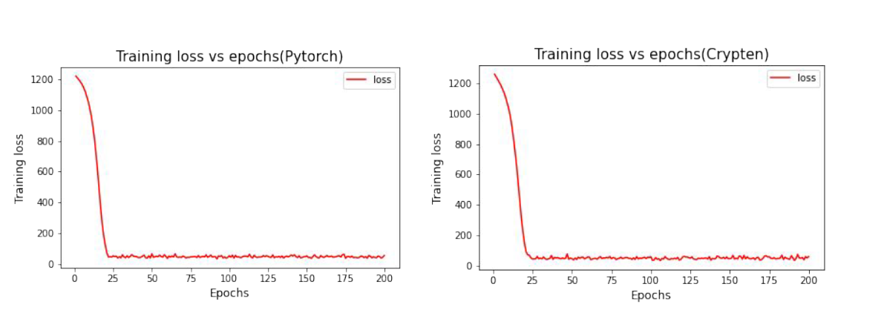
Training Loss
Similar graphs for both CrypTen and standard PyTorch
indicates that the MPC implementation is correct
Notes:
While training, Crypten performed as good as the standard Pytorch implementation using SGD optimiser, as evident from Figure. We obtained similar graphs for both Crypten and Standard Pytorch implementation of GCN. This confirms that MPC implementation on GCN is working correctly as desired.

Slide 13
Some drawbacks and issues of GCN interpolation
Small training data
GCN doesn’t return a confidence score
Test points need to be neighbours of known points
Crypten doesn’t support Adam optimizer which gave better result with Pytorch
Notes:
However, there were some drawbacks and issues of using GCN for interpolation.
Some of these are,
As mentioned before, the data is very sparse with only 2% known grid values within an hour. Less data leads to bad predictions.
GCN does not convey the uncertainty in prediction by any confidence scores but only returns a predicted value
For prediction using GCN, the unknown points should be neighbors of some known points. Only then GCN can predict the values at the unknown point
Crypten has very limited functions as of now. It only currenlty supports an SGD optimiser. But we got good results in GCN using the Adam optimizer

Slide 14
GP for Interpolation
Notes:
Next we explore the Gaussion Process for interpolation on pollution values.

Slide 15
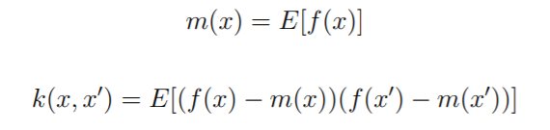
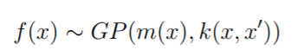
Gaussian Process
Definition: A Gaussian process is defined as a probability distribution over functions f(x), such that the set of values of f(x) evaluated at an arbitrary set of points x1,.. xn jointly have a Gaussian distribution.
A Gaussian process is completely specified by its mean function and co- covariance function.
And we can write Gaussian Process as,
Notes:
A Gaussian process is a collection of random variables, any finite number of which have a joint Gaussian distribution. A Gaussian process is completely specified by its mean function and covariance function. Gaussian Process Regression(GPR) is a non-parametric Bayesian regression approach which uses training data to provide interpolation estimates. For a known training input-output pair (X; y), GPR predicts the values of the underlying unobserved function, f*.

Slide 16
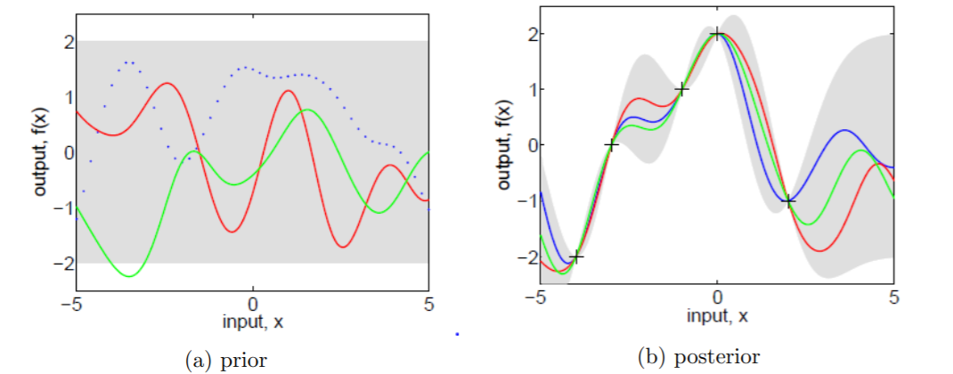
GP contd…
Notes:
We are usually not primarily interested in drawing random functions from the prior, but want to incorporate the knowledge that the training data provides about the function. To get the posterior distribution over functions we need to restrict this joint prior distribution to contain only those functions which agree with the observed data points and rejecting the ones that disagree with the observations. Complexity of model posterior can grow as more data are added. In both plots the shaded area represents the pointwise mean plus and minus two times the standard deviation for each input value (corresponding to the 95% confidence region)

Slide 17
Why use GP over GCNs
It not only makes predictions but allows to also estimate uncertainty in the predictions.
Make predictions on continuous input locations unlike GCN
Places a prior over functions directly rather than over model parameters.
Provide a convenient language for expressing domain knowledge. Intuitions are likely to be stronger in function space than parameter space e.g., smoothness constraints on function, trends over time, etc.
Notes:
Some of the advantages of using Gaussian Process over Graph Convolutional Networks for interpolation are:
The predictions in GP are probabilistic (Gaussian) so one can compute empirical confidence intervals and not only can make predictions at test points but also estimate uncertainty in the predictions with confidence scores.
Unlike GCN where only unknown points with known neighbours could be predicted, Gaussian Process regression allows to make predictions on continuous input locations
It also provide a convenient language for expressing domain knowledge. Common knowledge is expressed through priors and different choice of kernels.
In the problems with limited data, the data themselves aren’t sufficient to constrain the model predictions. Gaussian processes place a prior over functions directly rather than over model parameters.

Slide 18
Libraries explored for GP - Gpytorch
The key takeaways while trying to port different GP libraries to CrypTen were:
Libraries should be based on PyTorch to port to CrypTen
Large libraries like gpytorch have very large number of lines of code with specific classes defined on top of PyTorch which are not easy to port
Other smaller libraries like gptorch and pyro did not give very accurate and reliable results even in a non-MPC setting
Notes:
We explored different GP libraries and analysed how their code base can be ported to Crypten. The key takeaways while trying to port different GP libraries to Crypten were that libraries should be based on PyTorch to port to Crypten. We observed that large libraries like gpytorch have very large number of lines of code with specific classes like LazyTensors defined on top of PyTorch which are not easy to port to Crypten. Other smaller libraries like gptorch and pyro did not give very accurate and reliable results even in a non-MPC setting. So, we mostly focused on and studied gpytorch for porting Crypten to GP. GPyTorch is a Gaussian process library implemented using PyTorch and is designed for creating scalable, flexible, and modular Gaussian process models with ease.

Slide 19
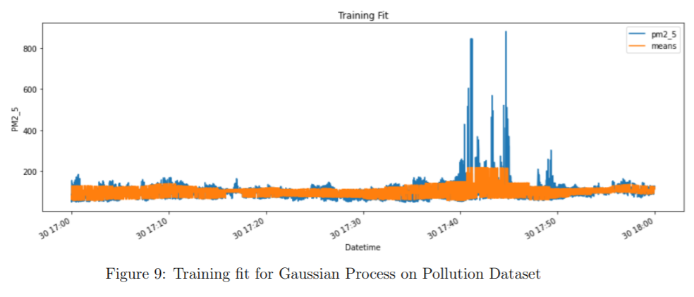
GP trained on Pollution Dataset
Notes:
This is the Gaussian Process implementation in gpytorch on Pollution Dataset

Slide 20
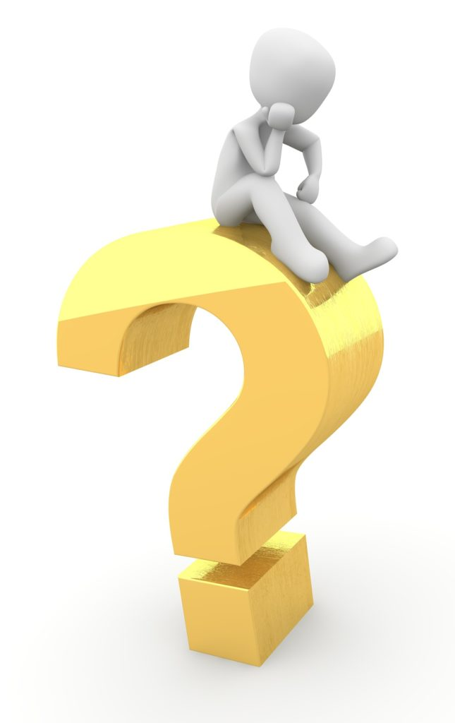
Challenges while deploying Crypten on gpytorch
Gpytorch converts pytorch tensor to lazy tensor which is not supported on Crypten tensor.
Bool comparisions in gpytorch are not compatible with MPC Tensor because Crypten doesn't support bool operations
Variational ELBO loss function from gpytorch is not supported by Crypten.
Crypten currently supports very limited set of loss functions.
CrypTendoes not support in-place operations and features like retain_graph=True in Autograd.
This Photo by Unknown Author is licensed under CC BY
Notes:
Gpytorch is a very large GP library implemented on Pytorch and deploying Crypten on gpytorch is not a trivial task, indeed a challeging one. Some of the challenges we are facing are:
gpytorch converts Pytorch tensor to LazyTensor for kernel and covariance matrix calculations which is not supported on Crypten tensor. •
Certain bool comparisons in gpytorch are not compatible with MPC Tensor because Crypten doesn’t support bool operations without converting it into plaintext.
3. GP uses Variational ELBO loss function from gpytorch library which is not supported by Crypten. Crypten currently supports very limited set of loss functions which makes the deployment of Crypten on GP very difficult.

Slide 21
Challenges: Porting to newer version of Crypten
Loss and gradients were abruptly going to very large values after 40 epochs.
After investigation, we observed following:
Bug on multiplying zero tensors for parties greater than 2.
Exploding loss and gradient occurred in multi party setting.
Lowering learning rate lead to delay in explosion.
CrypTen library is under development phase and still evolving.
Code written for older CrypTen made compatible to newer version of CrypTen.

Slide 22
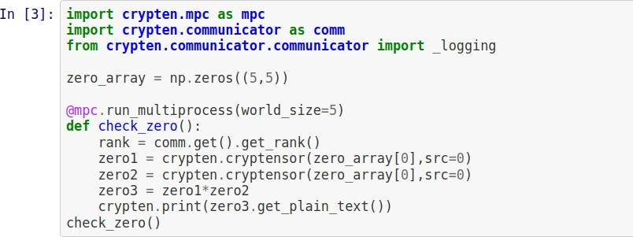


Zero tensor multiplication bug

Slide 23
Inference
Future Models:
GCN model has higher RMSE but low training time.
Low training time is attributed to very low size of model and dataset.
Develop larger and more sophisticated GCN models which may result in low RMSE values and training time.
CrypTen:
Communication and memory overhead is huge even for model and data size in kBs, which may increase further for more complex models.

Slide 24
PPML training
Privacy preserving – recent
Very few tools for training whole a lot of papers and research
- Even the most backed tool not working as desired
2 use case- trucks in highway-pollution & driving profiling
In collaboration with trip – C, IIT Delhi- trucks are instrumented – rewards to drivers-same vehicles
Crypten – most mature and researched software ( from Facebook)

Slide 25
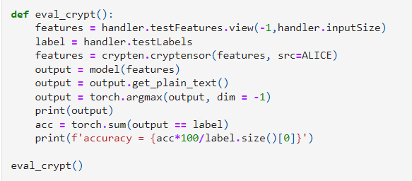
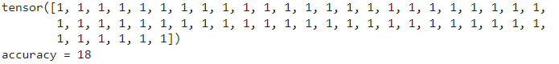
Challenges in Deployment to Crypten
Very slow convergence of loss as compared to Pytorch
Low accuracy in model due to mode collapse (predicting only one class label)

Slide 26
Deployment to Crypten
We made the following observations:
Crypten==1.0 (version1) is much faster as compared to the Crypten==4.0(latest version)
There is an issue of exploding loss values which is not found in the previous version.

Slide 27

Roads Ahead
In collaboration with Microsoft Research team, we will be exploring the deployment of crypten on our above usecases
Exploring the ease and usage of secure MPC library Crypten
Develop a working library for GP ported with Crypten for secure computations of interpolation on grid points.
Understand the accuracy-vs- latency trade-offs of our implementation
Notes:
Currently, we are exploring the ease and usage of secure MPC library Crypten and trying to port Crypten in Gaussian Process for performing the interpolation task. We are currently facing several challenges in this deployment of Crypten to GP as mentioned above. Crypten’s framework needs significant coding efforts as Crypten currently supports few ML functions that need to be extended. The next task is to develop a working library for GP ported with Crypten for secure computations of interpolation on grid points. Next, we will analyze the accuracy-vs-latency trade-offs of our implementation. As pollution is a dynamically changing phenomena, and the interpolation has to run periodically, instead of a single shot ML model training, thus latency of model training using Crypten is important. Based on the trade-off analysis of and finding the bottleneck of computation, we will try appropriate optimizations. The work will this involve understanding of cryptographic protocols, ML and systems.

Slide 28
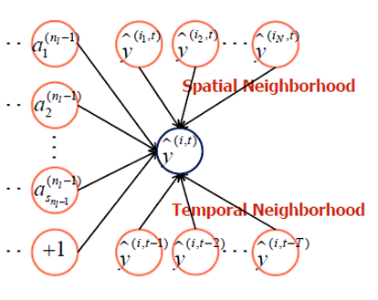
Spatio-temporal models
Captures temporal dependencies apart from the spatial ones.
Whereas GCN only incorporated spatial data
Notes:
However, traffic forecasting has always been considered an “open” scientific issue, owing to the constraints of urban road network topological structure and the law of dynamic change with time. To capture the spatial and temporal dependences simultaneously, we propose a novel neural network-based traffic forecasting method, the temporal graph convolutional network (T-GCN) model, which is combined with the graph convolutional network (GCN) and the gated recurrent unit (GRU). Specifically, the GCN is used to learn complex topological structures for capturing spatial dependence and the gated recurrent unit is used to learn dynamic changes of traffic data for capturing temporal dependence. Then, the T-GCN model is employed to traffic forecasting based on the urban road network. Experiments demonstrate that our T-GCN model can obtain the spatio-temporal correlation from traffic data and the predictions outperform state-of-art baselines on real-world traffic datasets.

Slide 29
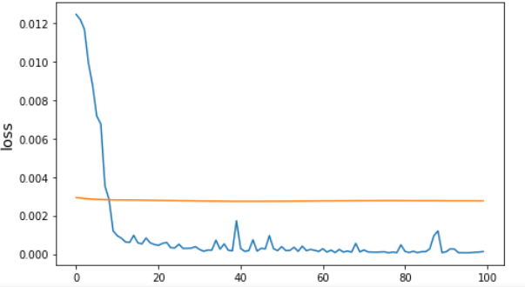
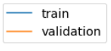
Training GCN_LSTM
Train time callbacks 23.60457840000163 1/1 [==============================] - 2s 2s/step Test RMSE: tf.Tensor(34.03627575547981, shape=(), dtype=float64)
Notes:
Spatial
Spatial Dependence Modeling: Acquiring the complex spatial dependence is a key problem in traffic forecasting. The traditional convolutional neural network (CNN) can obtain local spatial features, but it can only be used in Euclidean space, such as images, a regular grid, etc. An urban road network is in the form of graph rather than two-dimensional grid, which means the CNN model cannot reflect the complex topological structure of the urban road network and thus cannot accurately capture spatial dependence
One is an 156*156 adjacency matrix, which describes the spatial relationship between roads. Each row represents one road and the values in the matrix represent the connectivity between the roads.
we use the GCN model [47] to learn spatial features from traffic data. As shown in Figure 4, assuming that node 1 is a central road, the GCN model can obtain the topological relationship between the central road and its surrounding roads, encode the topological structure of the road network and the attributes on the roads, and then obtain spatial dependence.
Temporal
Acquiring the temporal dependence is another key problem in traffic forecasting. At present, the most widely used neural network model for processing sequence data is the recurrent neural network (RNN). However, due to defects such as gradient disappearance and gradient explosion, the traditional recurrent neural
network has limitations for long-term prediction [50]. The LSTM model [51] and the GRU model [52] are variants of the recurrent neural network and have been proven to solve the above problems. The basic principles of the LSTM and GRU are roughly the same [53]. They all use gated mechanism to memorize as much long-term information as possible and are equally effective for various tasks. However, due to its complex structure,

Slide 30
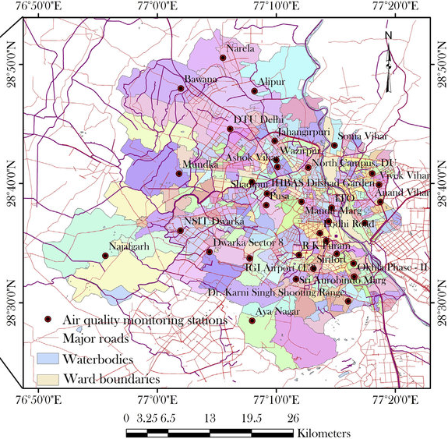
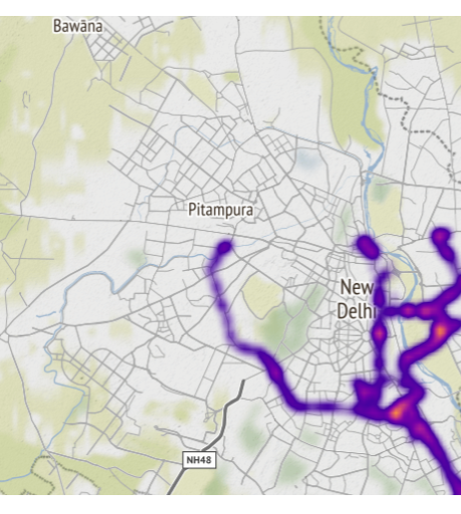
Static Delhi Pollution Board Sensors
Our Bus Route

Slide 31
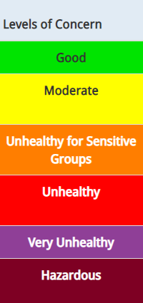
Why are we pursuing? Sample experiment, Sensor is cheap, gives real time estimates.
Inferences
How many sensors? 1 Sensor(priced ₹5,000) v₹ 5Lakh grade station sensor. Currently 8, if increased to 100, exceptional performance possible.
With this model, we can predict categorical accuracies for regions for bus visits.
Bus data can be used to alert in alarming situations aross abruptly in some region.
Static sensor replacement??

Slide 32
Inference of current model trainings
Current models state:
GCN - has higher RMSE, low training time.
GP, VGP, Graph Sage, training is slow in plaintext itself
Crypten training in fixed point does not converge in GCN
What Next?
Need to develop more sophisticated Graph models which may result in low RMSE values and training time.
MODEL | TrainTime_plain | TestRMSE_plain
GPR | 3433.04 | 29.74
Variational GPR | 1053.88 | 30.63
GraphSage | 4891.81 | 34.15
ANN | 141.42 | 32.49
GCN | 4.22 | 50.8
Notes:
Let us look at the inference of our current models
Current models state:
GCN model has higher RMSE but low training time. Low training time in GCN is attributed to very low size of model.
For other models like GP, VGP, Graph Sage, training is slow in plaintext itself, will be very slow in MPC with encrypted computations and communications.
Low training time in GCN is attributed to very low size of model.
Crypten training in fixed point does not converge in GCN
So this motivates the need to develop more sophisticated Graph models which may result in low RMSE values and training time.

Slide 33
Thank You!

Slide 34
References
https://github.com/facebookresearch/CrypTen
https://github.com/cornellius-gp/gpytorch
https://dl.acm.org/doi/pdf/10.1145/3411501.3419432
http://www.gaussianprocess.org/gpml/chapters/RW2.pdf
https://en.wikipedia.org/wiki/Inverse-variance\_weighting
https://eprint.iacr.org/2020/300.pdf
https://dl.acm.org/doi/pdf/10.5555/1882723.1882737
https://timesofindia.indiatimes.com/city/delhi/iit-team-to-mount-devices-on-200-cluster-buses-to-check-air-pollution/articleshow/69965333.cms
https://journals.plos.org/plosone/article?id=10.1371/journal.pone.0174959
https://github.com/jair-jr/driverBehaviorDataset

